Slide 1
Cloud Computing: SOA Design Patterns, Part II
Vijay Dialani, PhD
Boise State University
vijaydialani@boisestate.edu
©All rights reserved by the author

Slide 2
Scalability Design Patterns
We’ll discuss the following patterns:
Decoupled Invocation—Handle normal request loads, peak request loads, and
continuous periods of time at high load without failing
Parallel Pipelines —Build services that maintain state and high throughput
Gridable Service—Build services to handle computationally intense tasks in a scalable manner
Service Instance—Build services that are scalable in a simple and cost-effective way
Virtual Endpoint—Provide services with location transparency that gracefully
recover from failure without affecting service consumers
Service Watchdog—Increase availability and identify and resolve problems and
failures that are service-specific

Slide 3
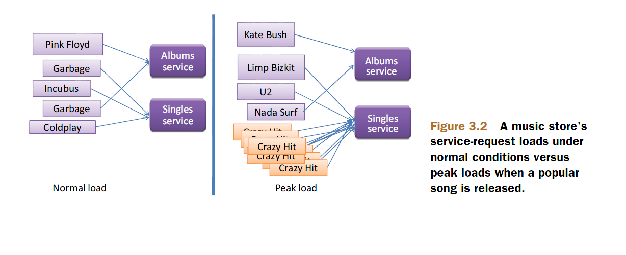
Decoupled Invocation – Use case

Slide 4
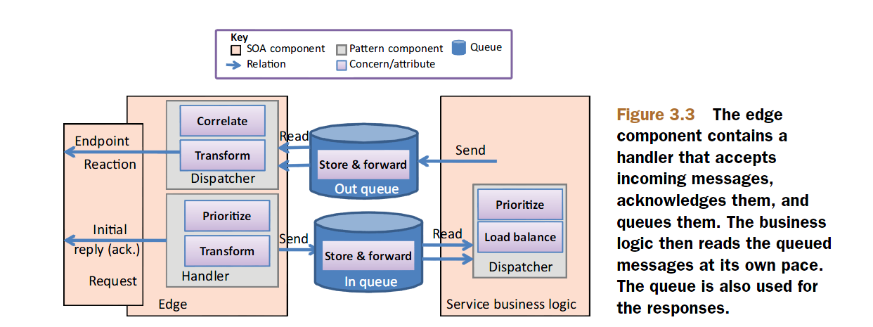
Decoupled Invocation
Problem:
How can a service handle normal request loads, peak request loads, and a continuous period of high load without failing?
Solution:
Utilize the Decoupled Invocation pattern and separate replies from requests: acknowledge receipt at the service edge, put the request on a reliable queue, and then load-balance and prioritize the handler components that read from the queue.

Slide 5
Assignment-2 Discussions
How will we adapt the decoupled invocation pattern to the Social Network
developed as a part of assignment-1?
Which queues will we create for request and response?
Which serialized classes do we need?
How will we monitor queue performance?

Slide 6
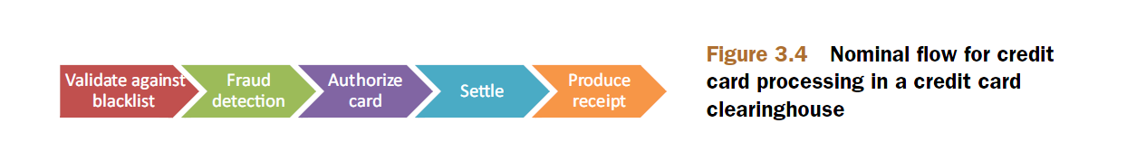
Parallel Pipelines – Use case
Problem:
How can you build services that maintain state and high throughput?

Slide 7
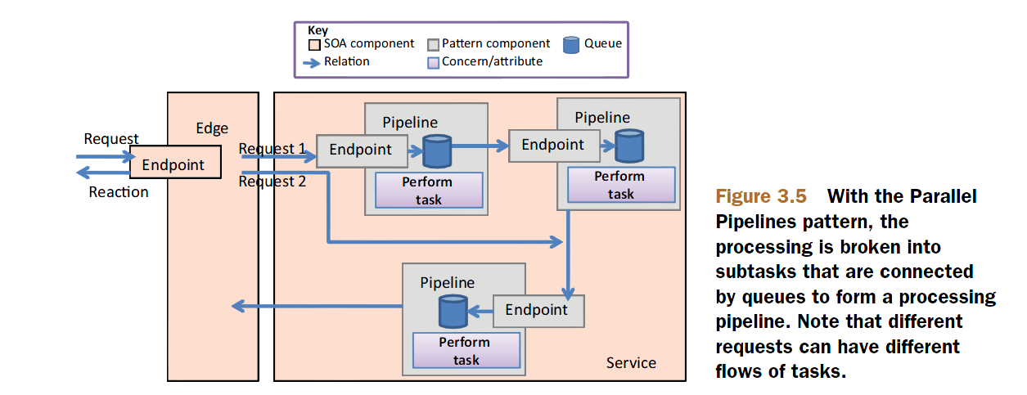
Parallel Pipelines

Slide 8
Parallel Pipelines
The following are advantages of the Parallel Pipelines approach:
The pipelines pattern is relatively simple to implement.
Pipelines are easy to test because they operate independently (you can test them with the same technologies and principles you use to test the services that include the pipelines).
Because the overall problem is broken into subtasks, each pipeline component tends to be simpler.
To scale the solution, you can distribute the pipeline across as many servers as needed.
When you need to scale the solution, the simplest option is to put each pipeline on its own server.

Slide 9
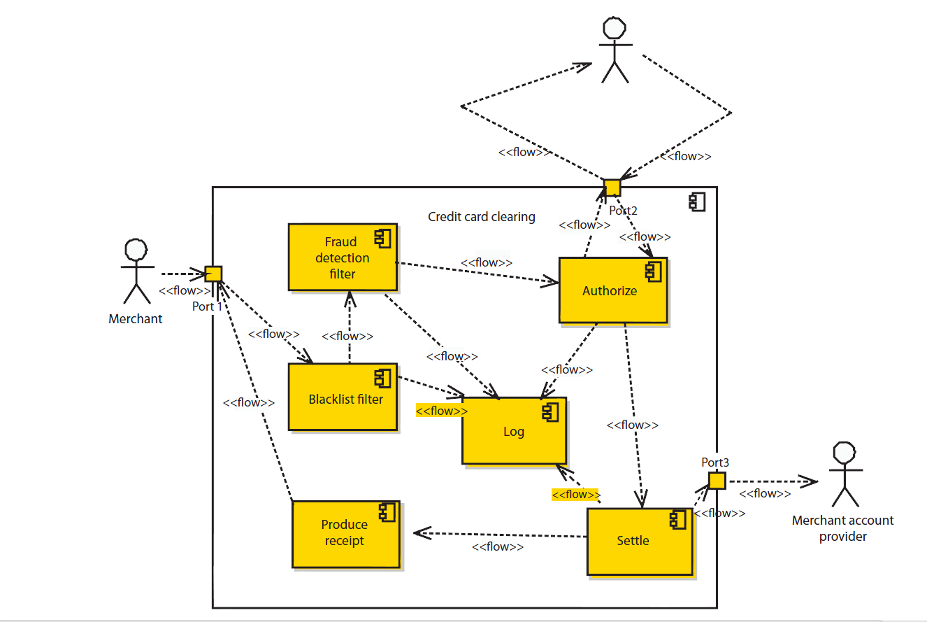
Parallel Pipelines

Slide 10
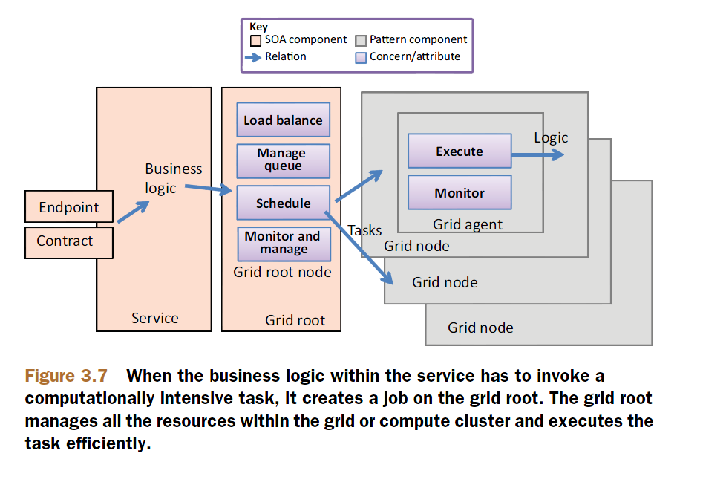
Gridable Service
Problem
How can you build services to handle computationally intense tasks in a scalable manner?
Solution

Slide 11
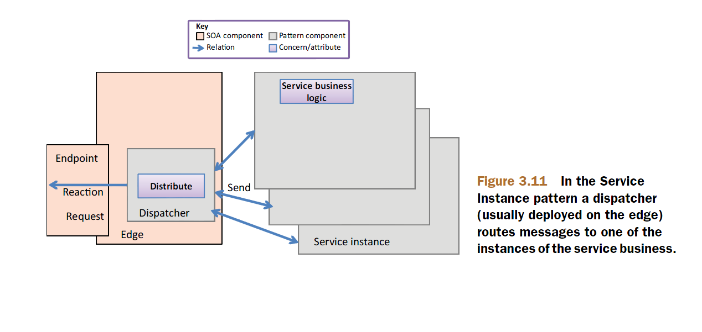
Service Instance Pattern

Slide 12
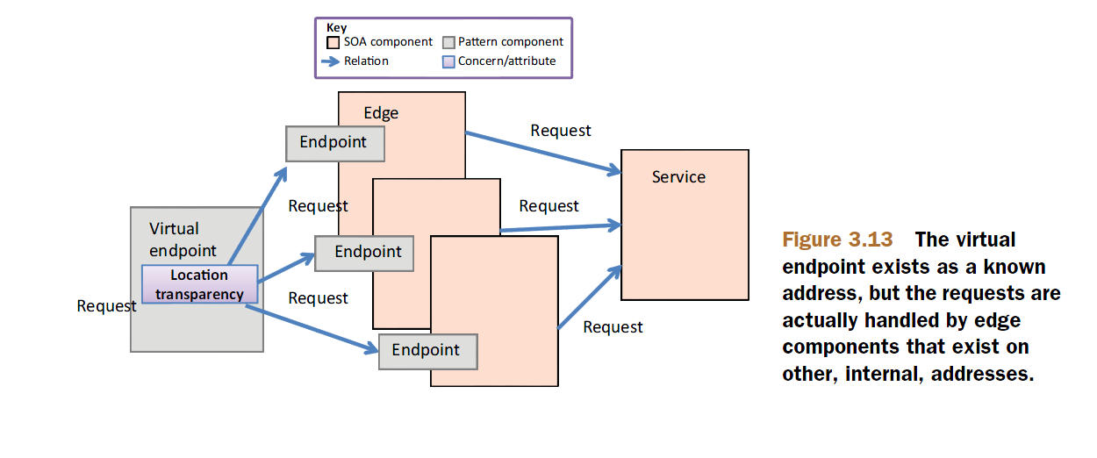
Virtual Endpoint Pattern

Slide 13
Assignment-2 Discussions
How will you implement the Service Instance Pattern for the Social Network Services developed in Assignment-1?
What will be the HA-Proxy Configuration?

Slide 14
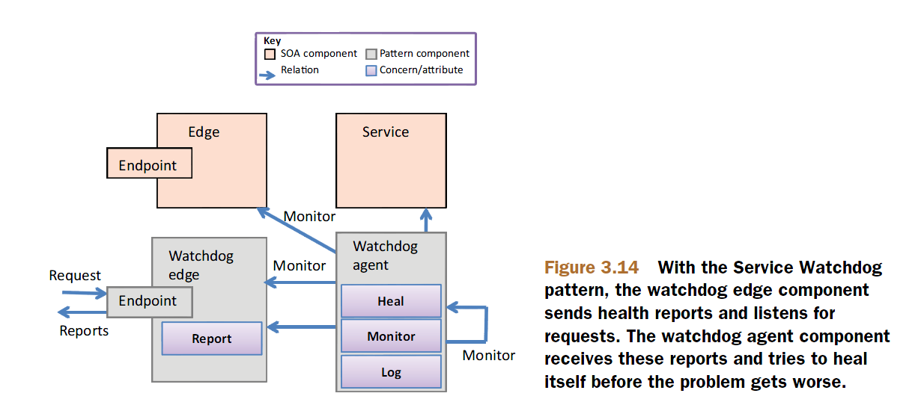
Watchdog Pattern
How can you increase availability by identifying and resolving problems and failures that are service-specific?

Slide 15
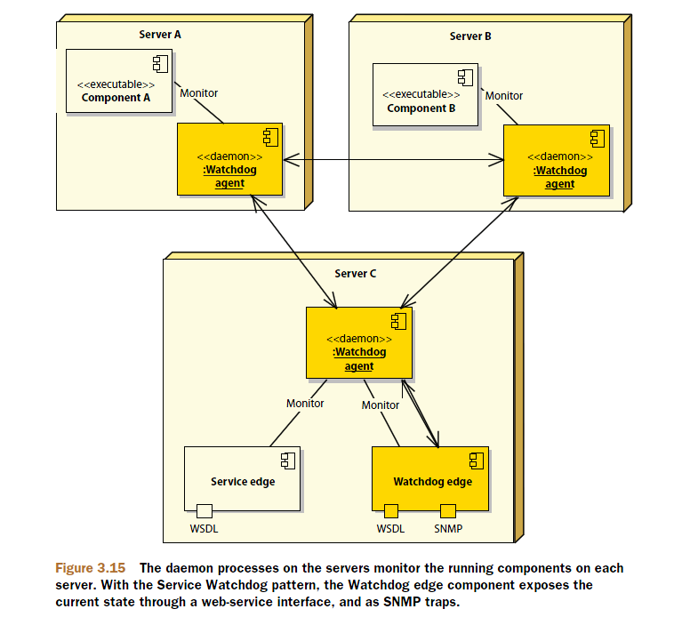
Watchdog Pattern

Slide 16
Assignment-2 Discussions
How will you implement the Watchdog pattern for your service?
How will you expose the Watchdog’s Edge component?

Slide 17


SOA Design Patterns

